Slide 1
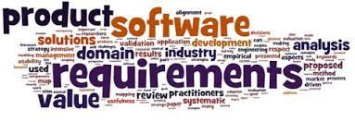
Software Requirement Engineering
Requirement Engineering
Lecture # 3

Slide 2



The essential software requirement
Requirements from the customer’s perspective
Good practices for requirements engineering
The business analyst

Slide 4
Content
The Essential Software Requirement
▫ Requirement Engineering
▫ Sub-discipline of Requirement Engineering
🞄 Requirements development and
🞄 Requirement Management
▫ Requirement Engineering Process

Slide 5
Requirement Engineering
According to International Requirements Engineering Board (IREB):
Requirements engineering is a cooperative, iterative, incremental process, aimed at guaranteeing that:
▫ All relevant requirements are known and understood with the necessary degree of refinement,
▫ The stakeholders involved come to a satisfactory agreement concerning the known requirements,
▫ All requirements have been documented as defined by the documentation guidelines or specification guidelines.

Slide 7
Requirement Engineering
Requirements engineering is the sub-discipline of systems engineering and software engineering that encompasses all project activities associated with understanding a product's necessary capabilities and attributes. Includes both requirements development and requirements management.

Slide 8
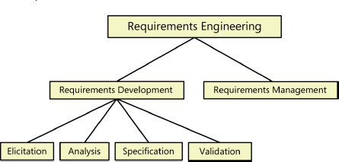
Sub-disciplines of Requirements Engineering
Figure: Sub-discipline of Software Requirements Engineering

Slide 10
Requirement Development
“The process of defining a project's scope, identifying user classes and user representatives, and eliciting, analyzing, specifying, and validating requirements. Its product is a set of documented requirements that defines some portion of the product to be built.”

Slide 11
Requirement Development (Cont..)
Requirements development is subdivided into:
▫ Elicitation,
▫ Analysis,
▫ Specification, and
▫ Validation.
These sub-disciplines encompass all the activities involved with exploring, evaluating, documenting, and confirming the requirements for a product.

Slide 12
Elicitation
Elicitation encompasses all of the activities involved with discovering requirements, such as:
▫ Interviews,
▫ Workshops,
▫ Document analysis,
▫ Prototyping,
▫ Test Scenarios
▫ and others.

Slide 13
Elicitation (Cont..)
The key actions of Elicitation process are:
▫ Identifying the product’s expected user classes and other stakeholders.
▫ Understanding user tasks and goals and the business objectives with which those tasks align
▫ Learning about the environment in which the new product will be used.
▫ Working with individuals who represent each user class to understand their functionality needs and their quality expectations.

Slide 14
Elicitation (Cont..)
Requirements elicitation typically takes either a usage-centric or a product-centric approach.
The usage-centric strategy emphasizes understanding and exploring user goals to derive the necessary system functionality.
The product-centric approach focuses on defining features that you expect will lead to marketplace or business success.

Slide 15
Analysis
“The process of classifying requirements information into various categories, evaluating requirements for desirable qualities, representing requirements in different forms, deriving detailed requirements from high-level requirements, negotiating priorities, and related activities.”

Slide 16
Analysis (Cont..)
Following are the principal activities:
▫ Analyzing the information received from users to distinguish their task
goals from functional requirements, quality expectations, business rules, suggested solutions, and other information
▫ Decomposing high-level requirements into an appropriate level of detail
▫ Deriving functional requirements from other requirements information
▫ Understanding the relative importance of quality attributes

Slide 17
Analysis (Cont..)
Following are the principal activities:
▫ Allocating requirements to software components defined in the system architecture
▫ Negotiating implementation priorities
▫ Identifying gaps in requirements or unnecessary requirements as they relate to the defined scope

Slide 18
Specification
“The process of documenting a software application's requirements in a structured, shareable, and manageable form. Also, the product from this process.”
The principal activity is:
▫ Translating the collected user needs into written requirements and diagrams suitable for comprehension, review, and use by their intended audiences.

Slide 19
Validation
“The process of evaluating a project deliverable to determine whether it satisfies customer needs. Often stated as "Are we building the right product?”
(Verification: “Are we building the product right?”)
Requirements validation confirms that you have the correct set of requirements information that will enable developers to build a solution that satisfies the business objectives.

Slide 20
Validation (Cont..)
The central activities are:
▫ Reviewing the documented requirements to correct any problems before the development group accepts them.
▫ Developing acceptance tests and criteria to confirm that a product based on the requirements would meet customer needs and achieve the business objectives.

Slide 21
Requirement Development
Iteration is a key to requirements development success.
Plan for multiple cycles of exploring requirements, progressively refining high-level requirements into more precision and detail, and confirming correctness with users.

Slide 22


Slide 23
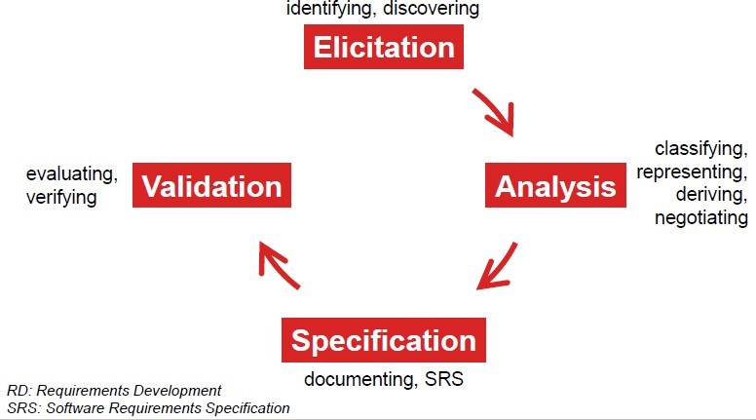
RD Process Framework

Slide 24
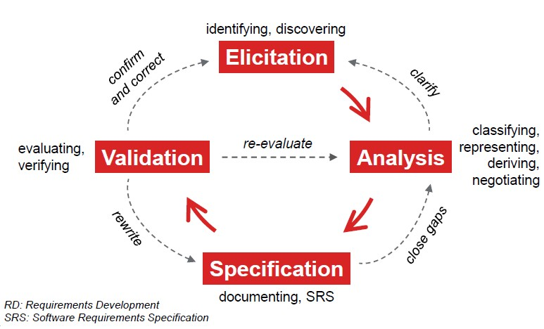
RD Process Framework

Slide 25


Slide 26
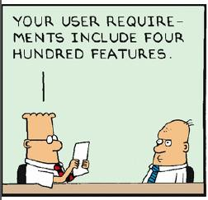
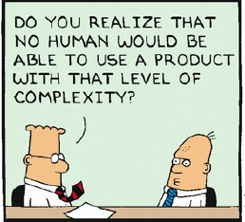
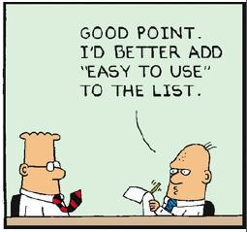
How much, how deep?

Slide 27
A Structured Approach to RD
1. Define stakeholders!
🞄 Who is interested in the system?
🞄 Who makes decisions?
🞄 Who are the users, managers, developers, etc.?
▫ In other words, WHO has influence on the software requirements?

Slide 28

A Structured Approach to RD

Slide 29
A Structured Approach to RD
2. Define goals!
🞄 Stakeholders have goals (define coarse goals)
🞄 These goals can be divided into more specific goals (i.e. granular goals)
▫ In other words, WHAT should be implemented or achieved?

Slide 30
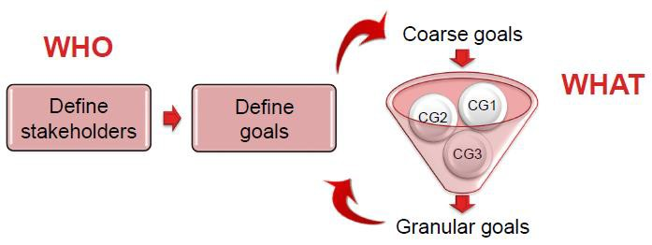
A Structured Approach to RD

Slide 31
A Structured Approach to RD
3. Define requirements!
🞄 Goals can be derived into concrete requirements
🞄 How to get to the requirements? (goal-based!)
🞄 Model those requirements using diagrams, templates, etc.
▫ In other words, HOW will the goals be achieved?

Slide 32
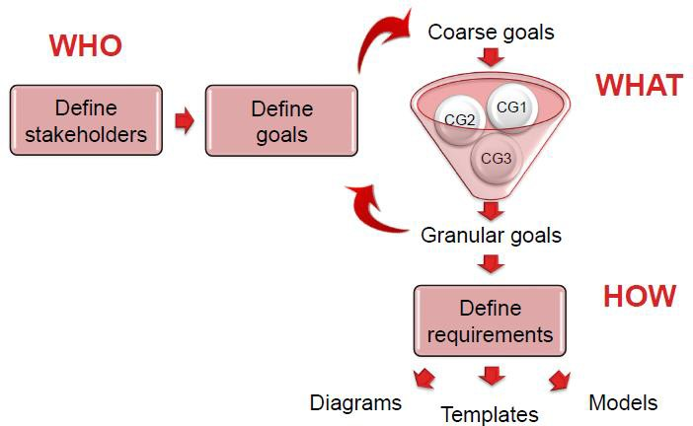
A Structured Approach to RD

Slide 33
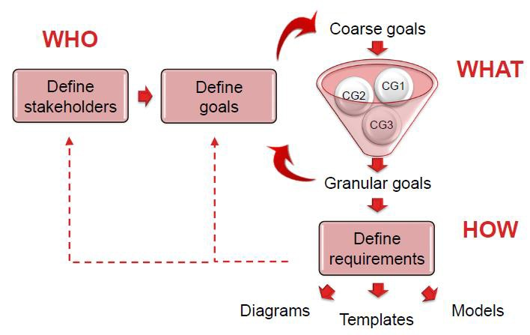
A Structured Approach to RD

Slide 34
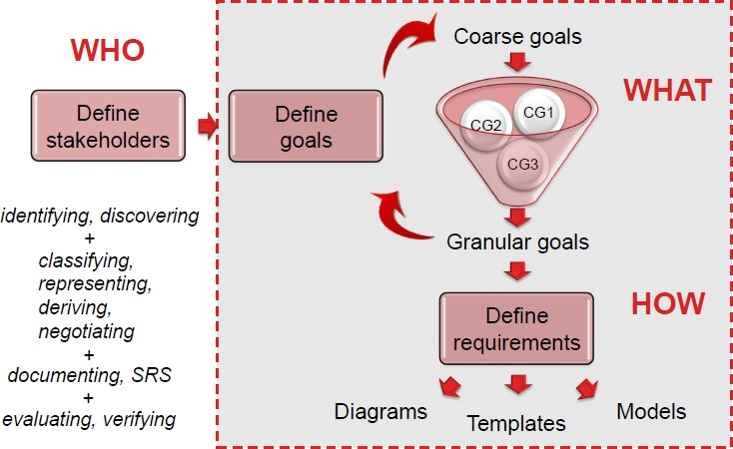
A Structured Approach to RD

Slide 36
Requirement Management
Requirements management activities include the following:
▫ Defining the requirements baseline, a snapshot in time that represents an agreed-upon, reviewed, and approved set of functional and nonfunctional requirements, often for a specific product release or development iteration.
▫ Evaluating the impact of proposed requirements changes and incorporating approved changes into the project in a controlled way.

Slide 37
Requirement Management (Cont..)
Requirements management activities include the following:
▫ Keeping project plans current with the requirements as they evolve
▫ Negotiating new commitments based on the estimated impact of requirements changes
▫ Defining the relationships and dependencies that exist between requirements
▫ Tracing individual requirements to their corresponding designs, source code, and tests
▫ Tracking requirements status and change activity throughout the project

Slide 38
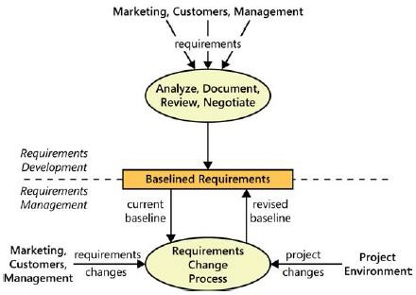
Boundary b/w RD and RM

Slide 39
When bad requirements happen to good people
Insufficient user involvement
Inaccurate planning
Creeping user requirements
Ambiguous requirements
Gold plating
Overlooked stakeholders

Slide 41
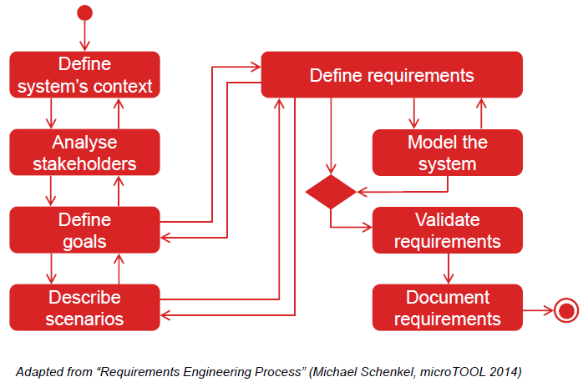
Requirement Engineering Process

Slide 42
Benefits of RE Process
Fewer defects in requirements and in the delivered product.
Reduced development rework.
Faster development and delivery.
Fewer unnecessary and unused features.
Lower enhancement costs.
Fewer miscommunications.
Reduced scope creep.
Reduced project chaos.
Higher customer and team member satisfaction.
Products that do what they are supposed to do.

Slide 43
Summary
The Essential Software Requirement
▫ Requirement Engineering
▫ Sub-discipline of Requirement Engineering
🞄 Requirements development and
🞄 Requirement Management
▫ Requirement Engineering Process

